Slide 1
TimeSeries

Slide 2
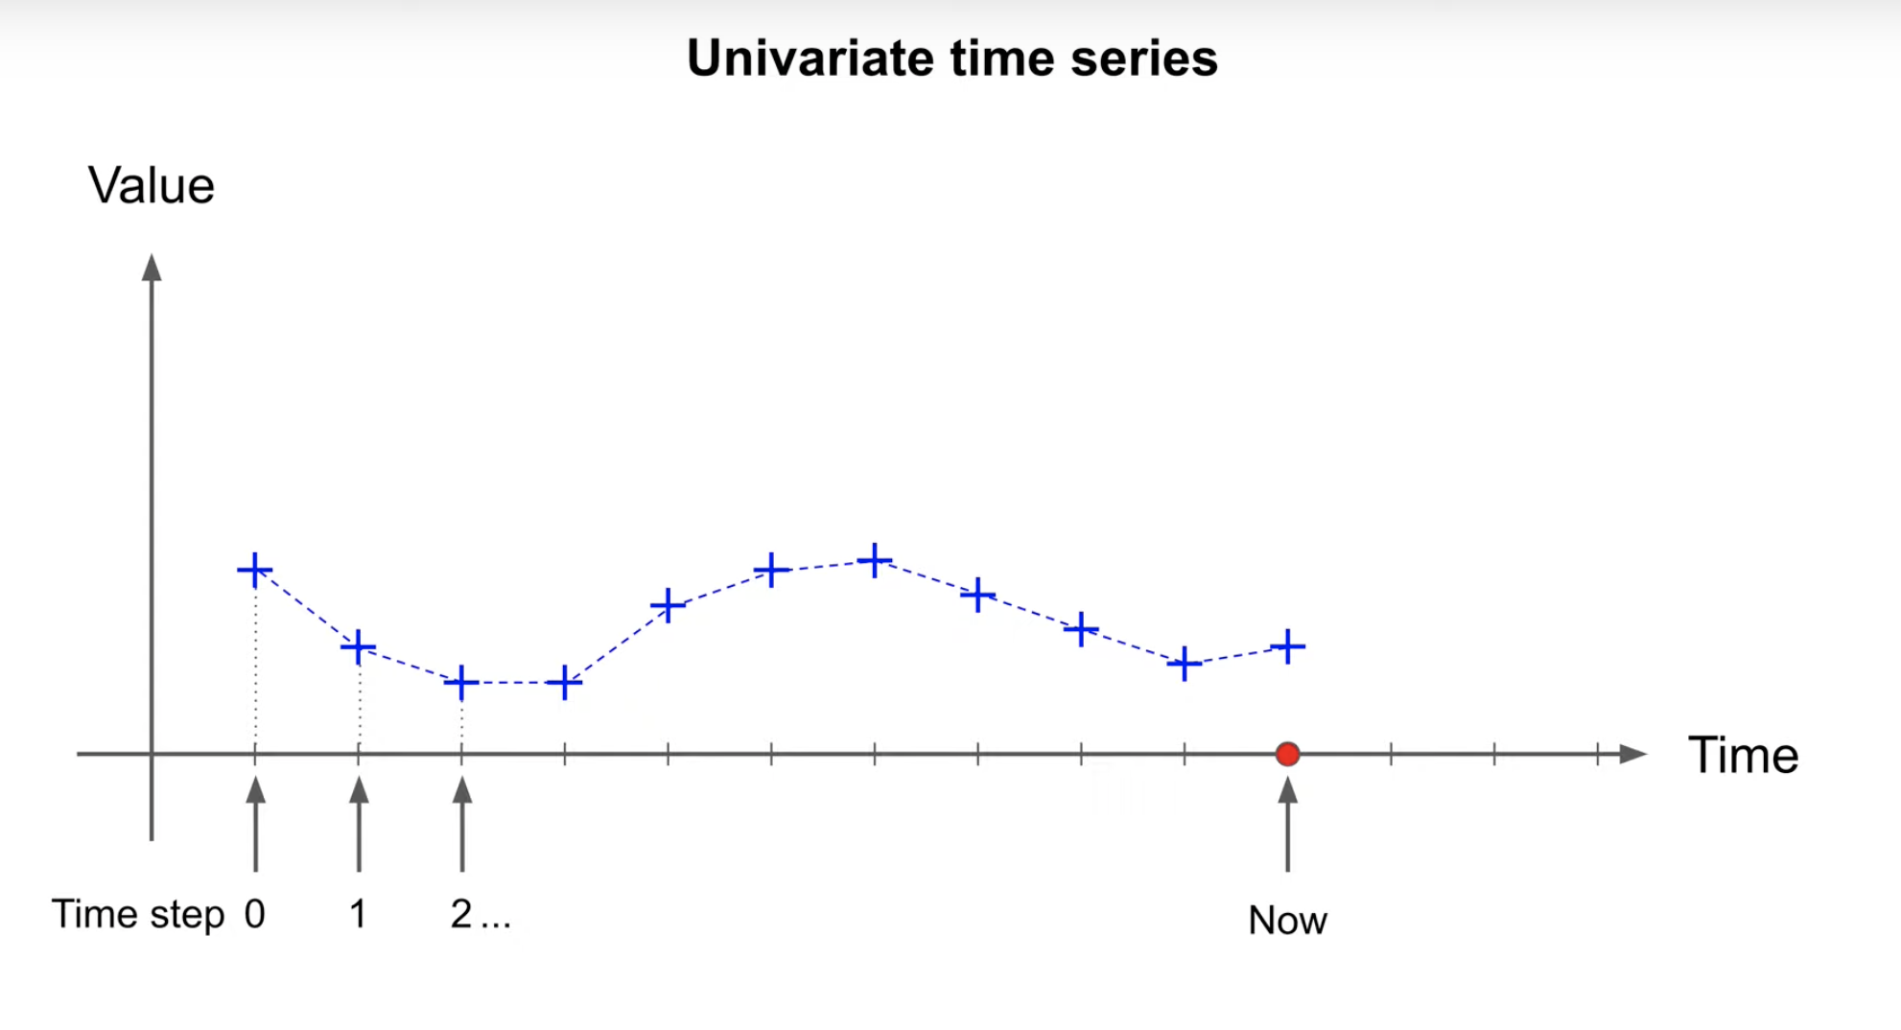
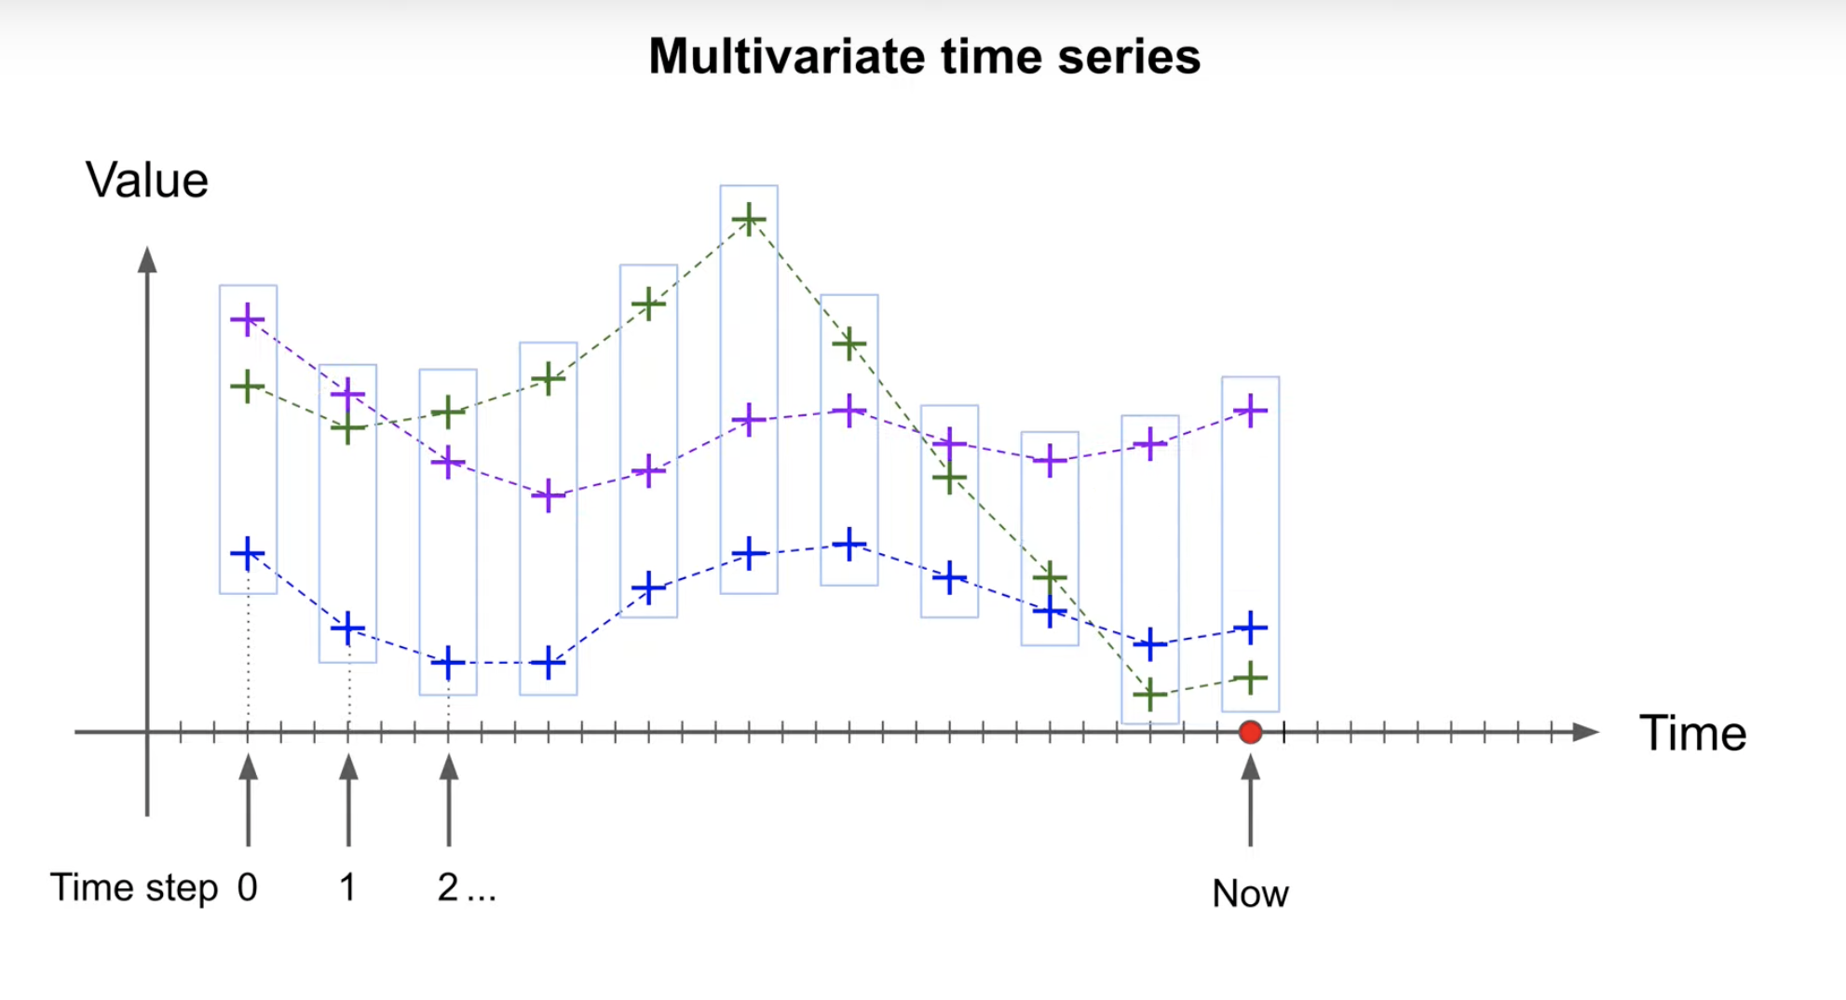
What is TimeSeries?
Its ordered sequence of values usually equally spaced over time every year, day, time, second (Any equal time interval)
Univariate Time Series (Single value in each timestamp)
Multivariate Time Series (Multiple value in each timestamp)

Slide 3
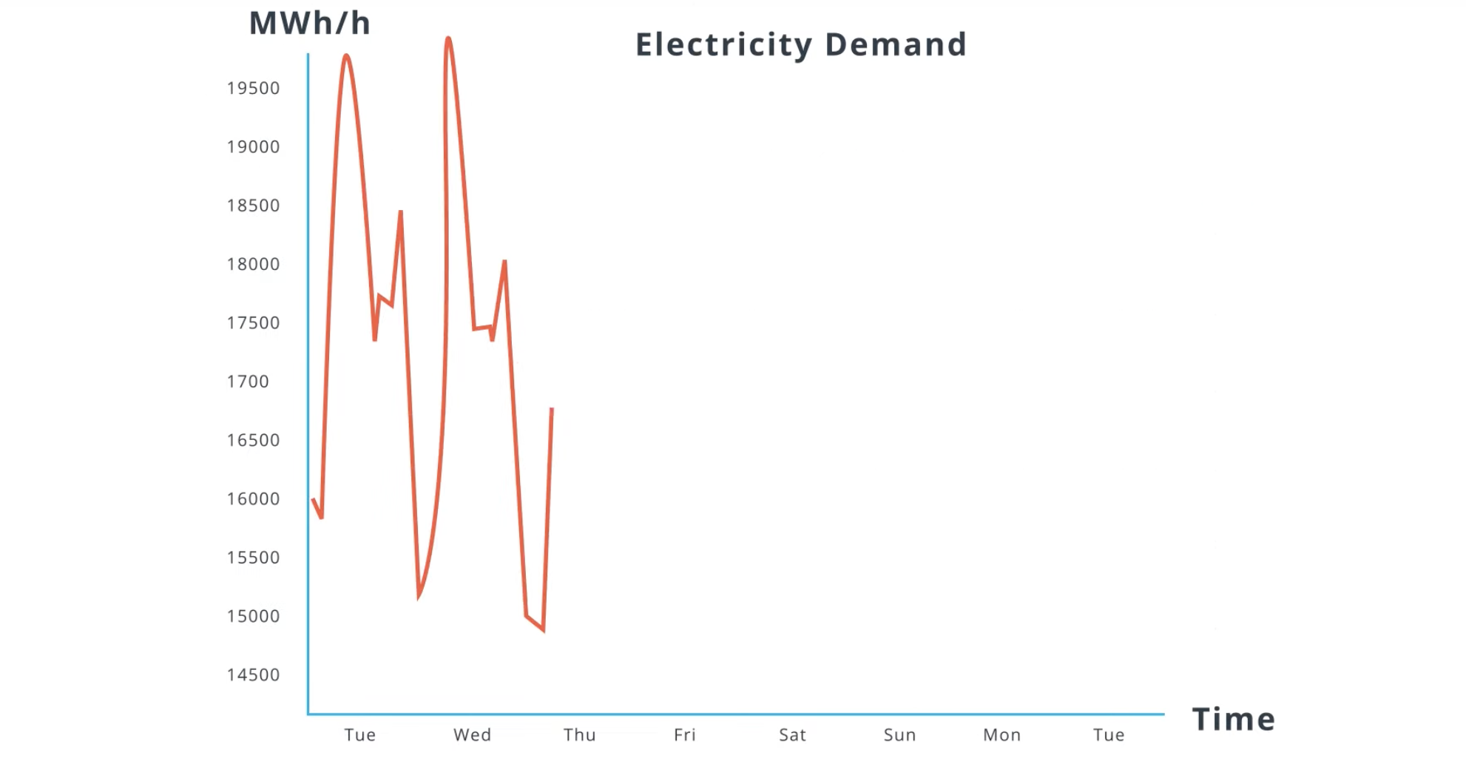
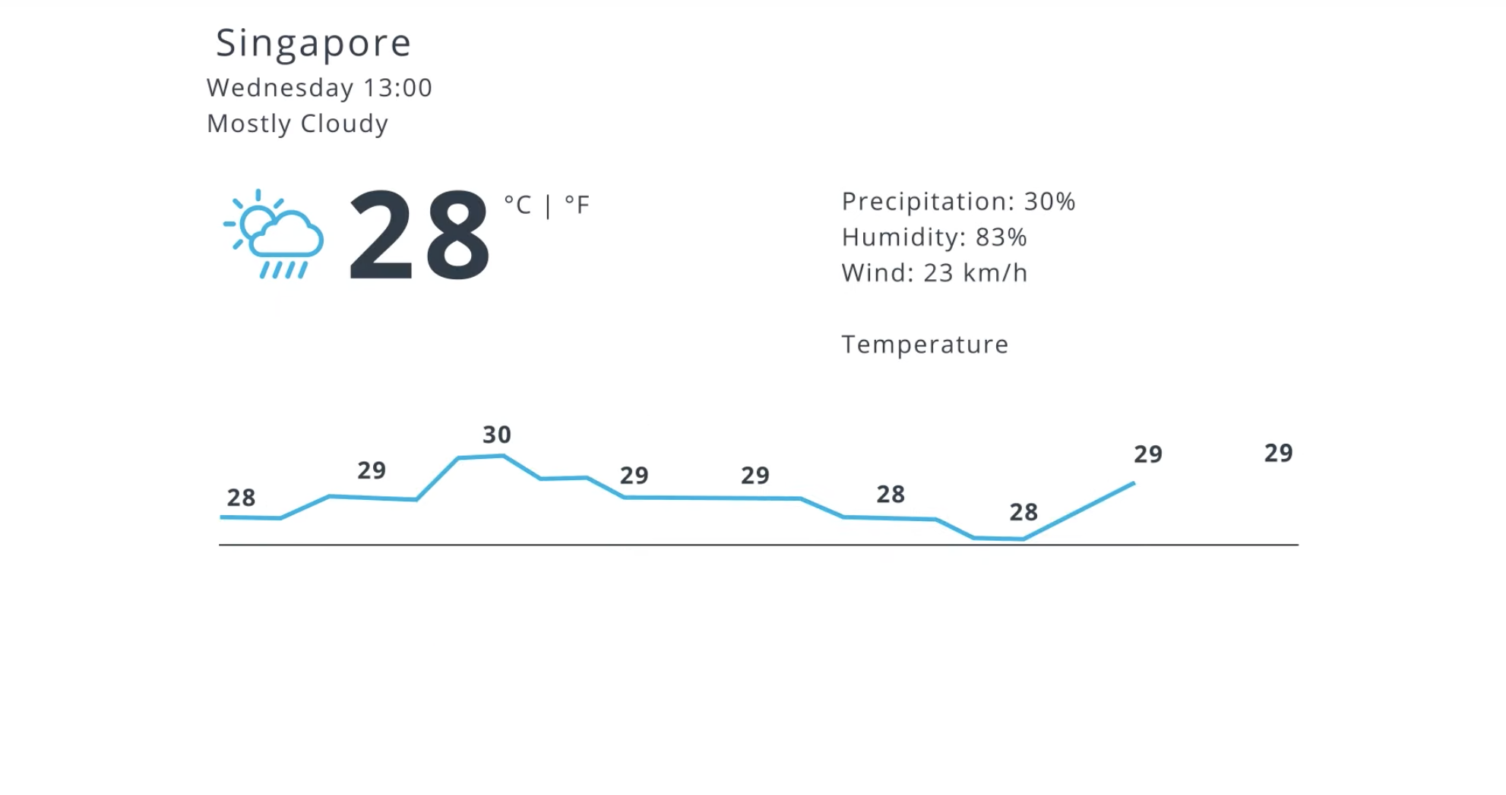
Univariate TimeSeries
Weather information
Electricity Demand

Slide 4
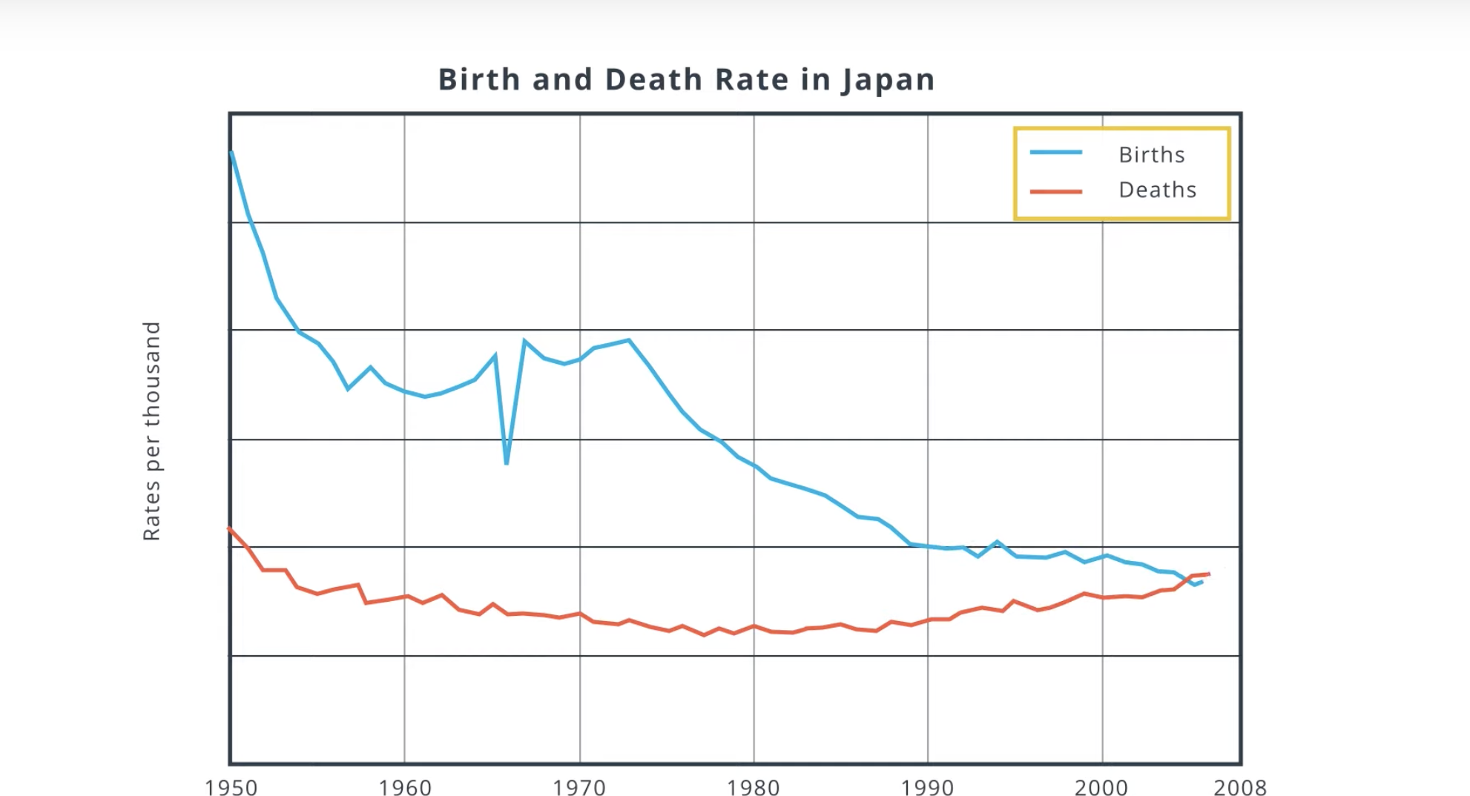
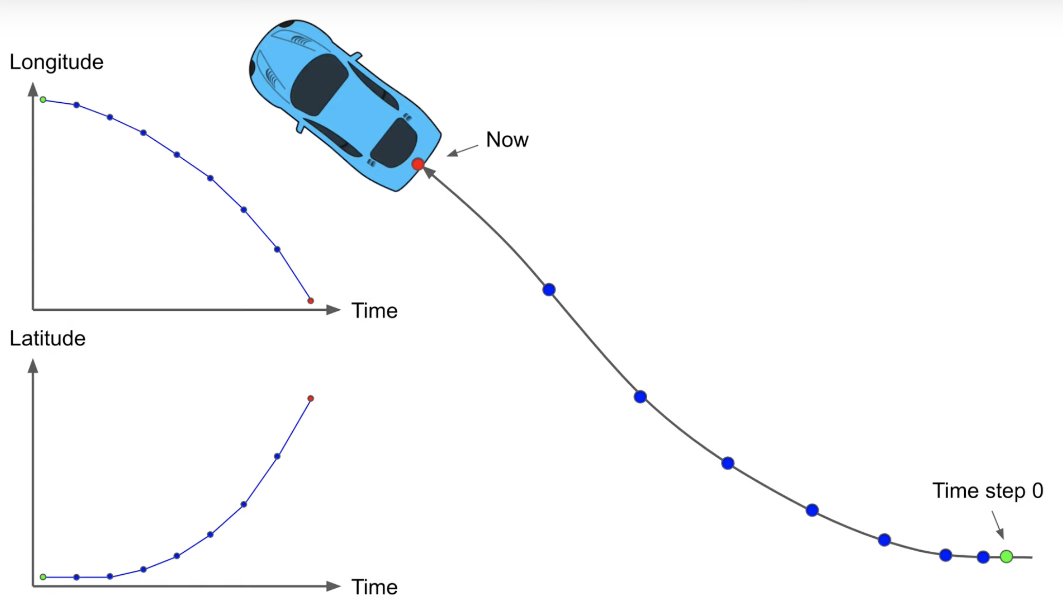
Multivarient TimeSeries

Slide 5
TimeSeries Applications
Forecasting: Predicting the future
Forecast stock price
Forecast temp
How many products you should manufacture to meet the demand
Predict Past
Study brain waves to better understand sleep cycles.
Monitor website traffic to detect abnormal activities
Recommendation engine

Slide 6
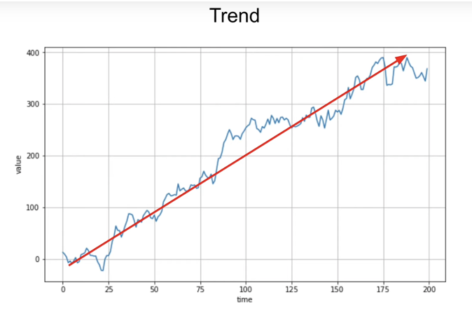
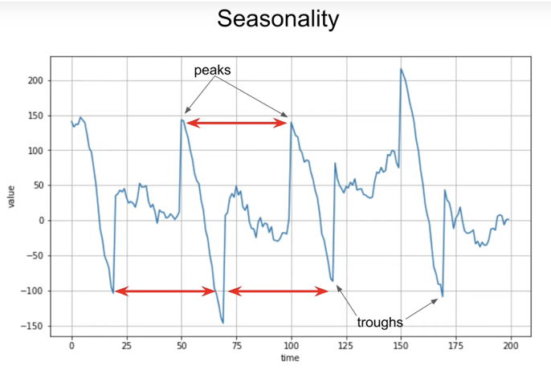
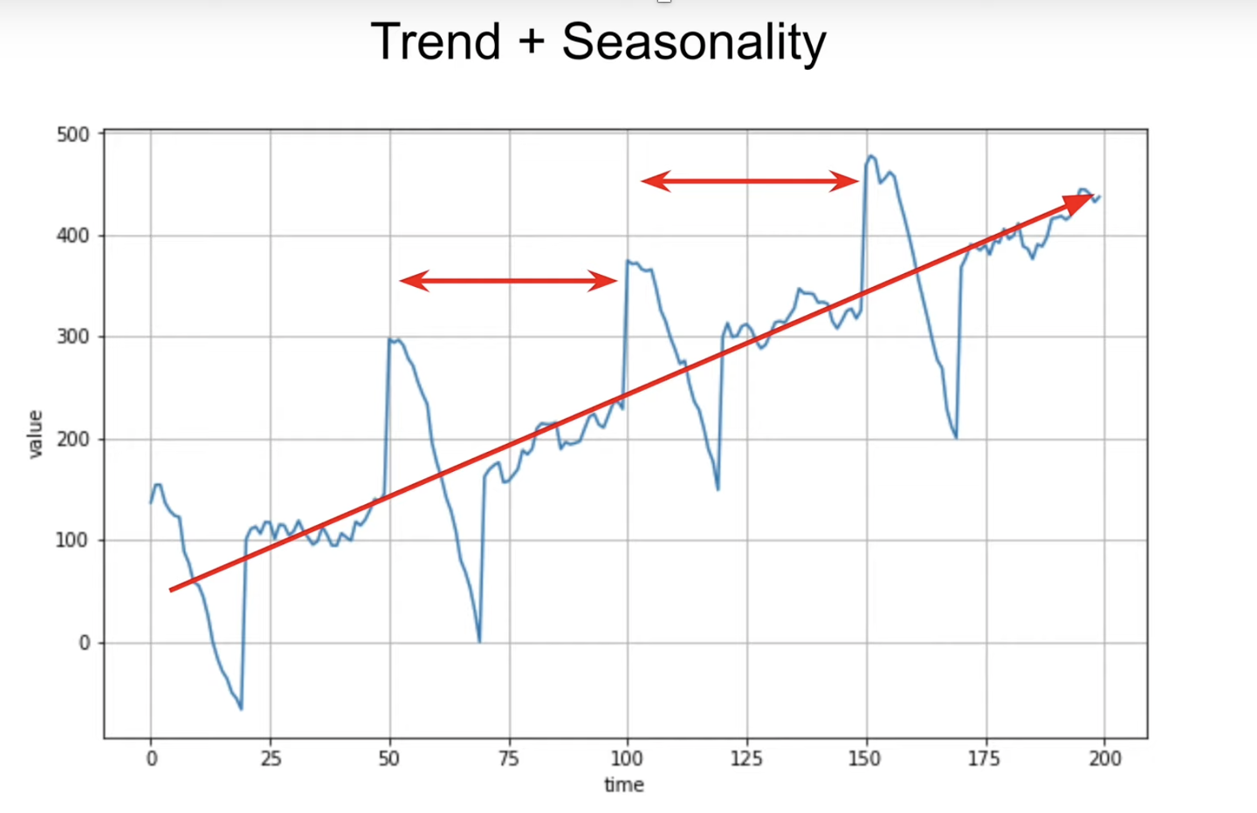
TimeSeries Common Patterns
Trend
Seasonality
Trend + Seasonality

Slide 7
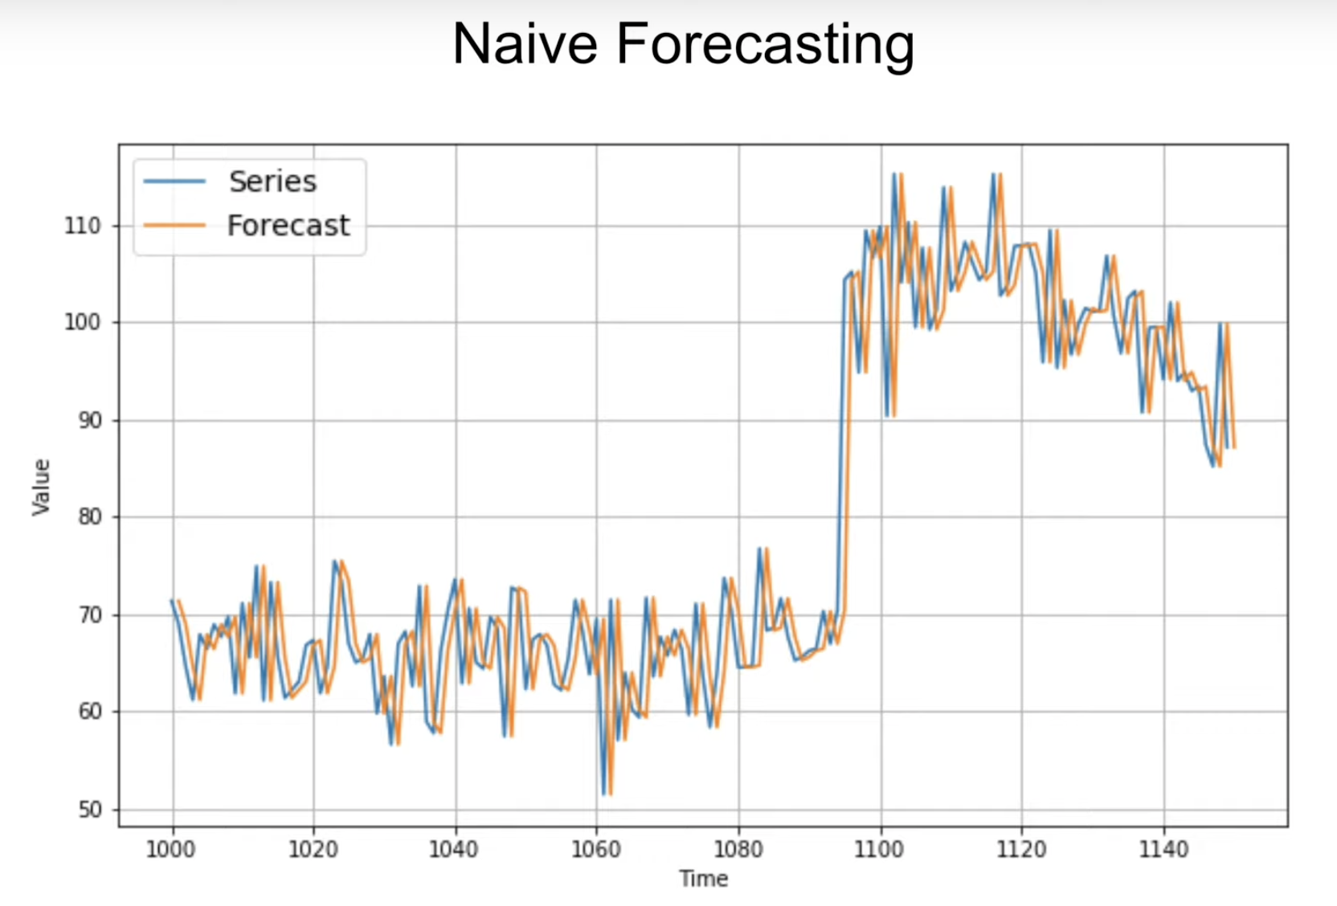
Forecasting: Naïve Forcasting
Naïve Forecasting: Last value and assume that the next value will be the same.

Slide 8
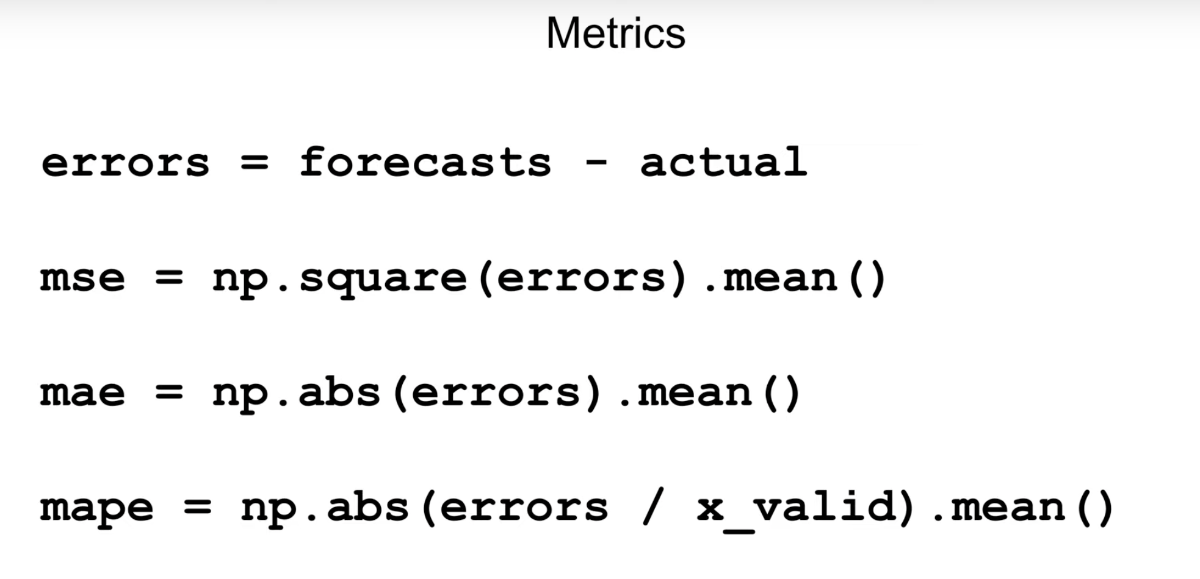
Measure Forecasting

Slide 9
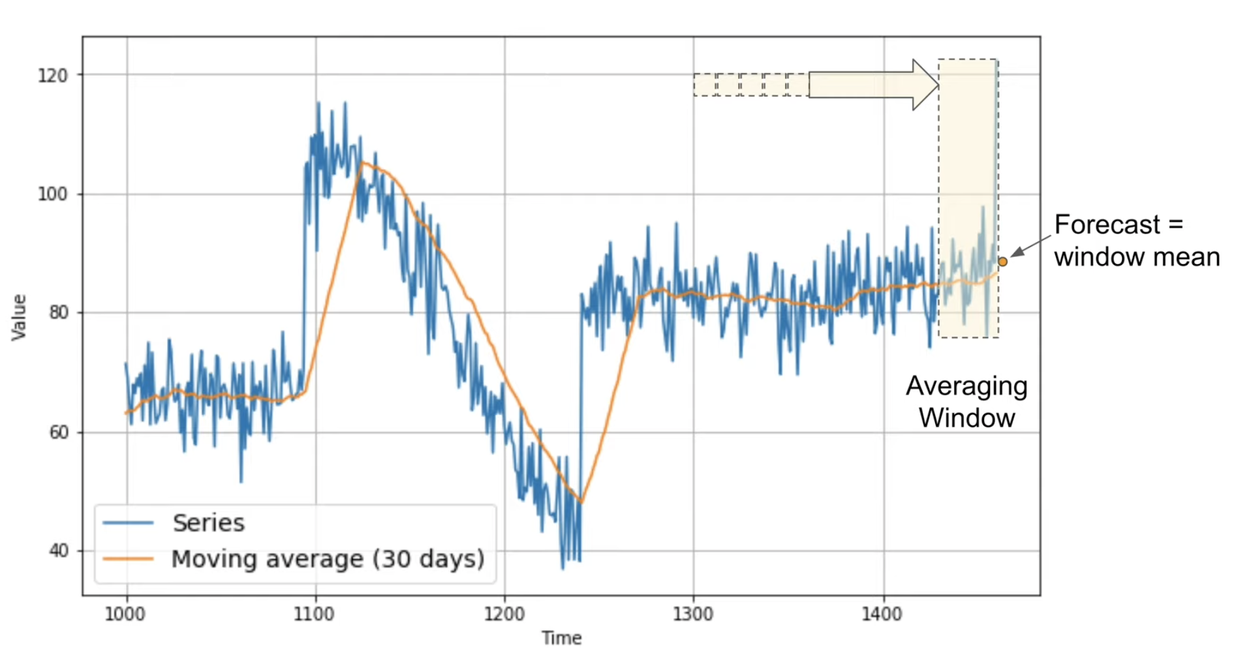
Forecasting: Moving Average
It’s mean of the past N values
Mean Absolute Error: 7.1
Not good for seasonality

Slide 10
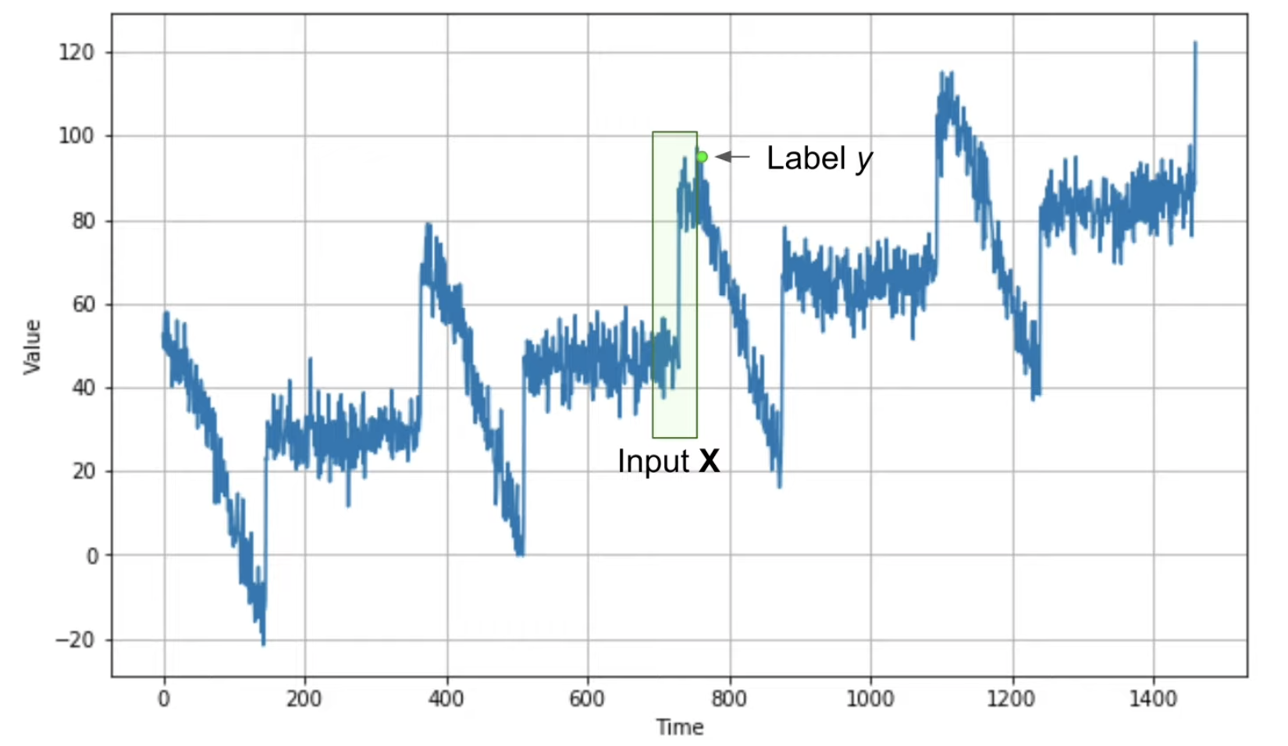
Time Windows

Slide 11
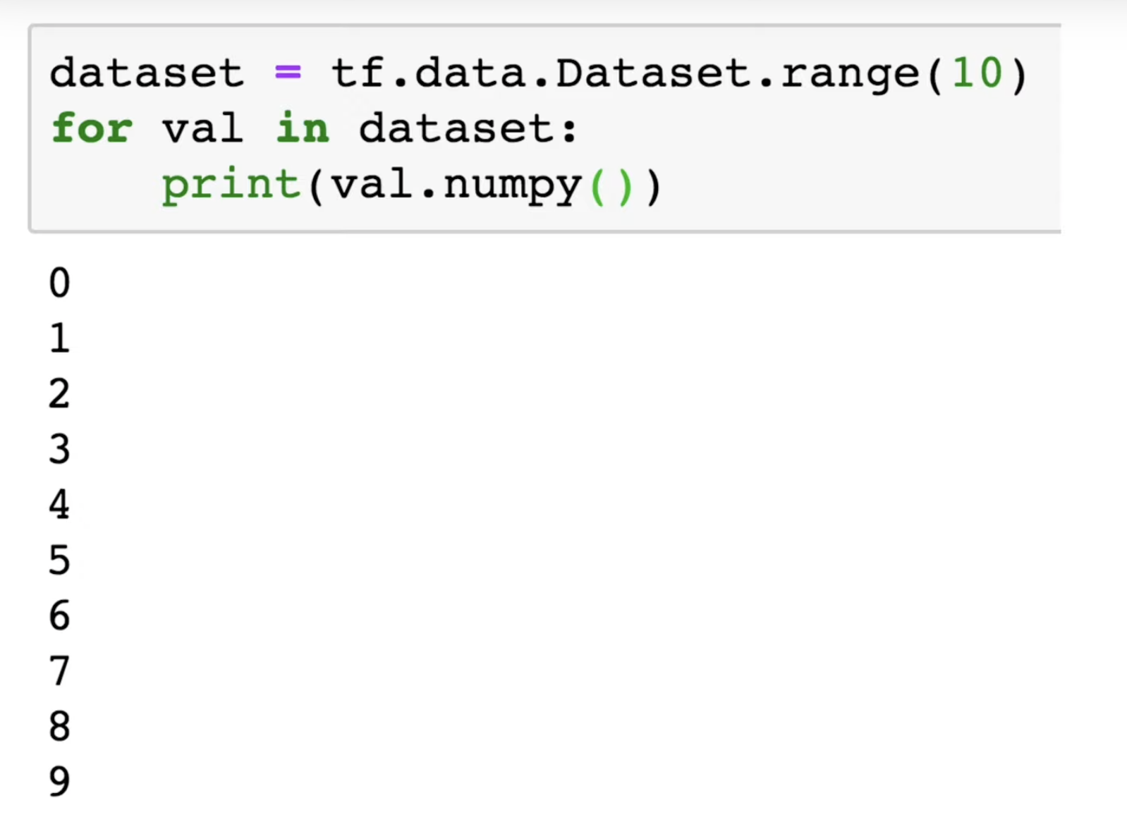
Time Windows

Slide 12
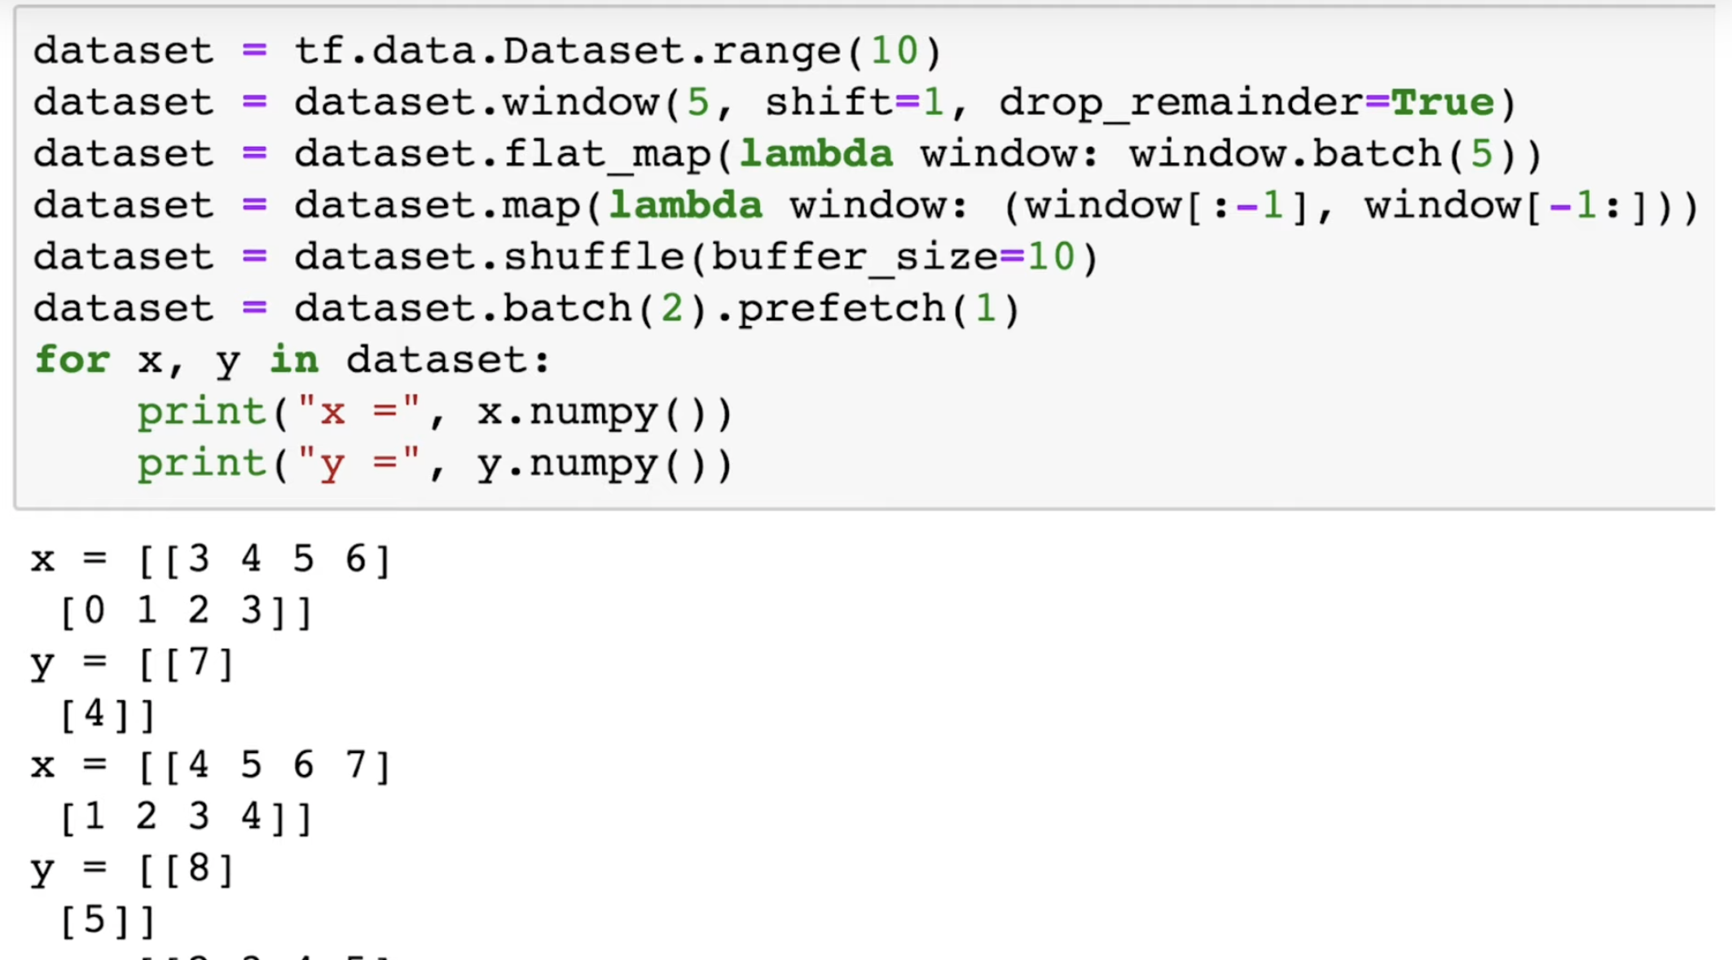
Time Windows

Slide 13
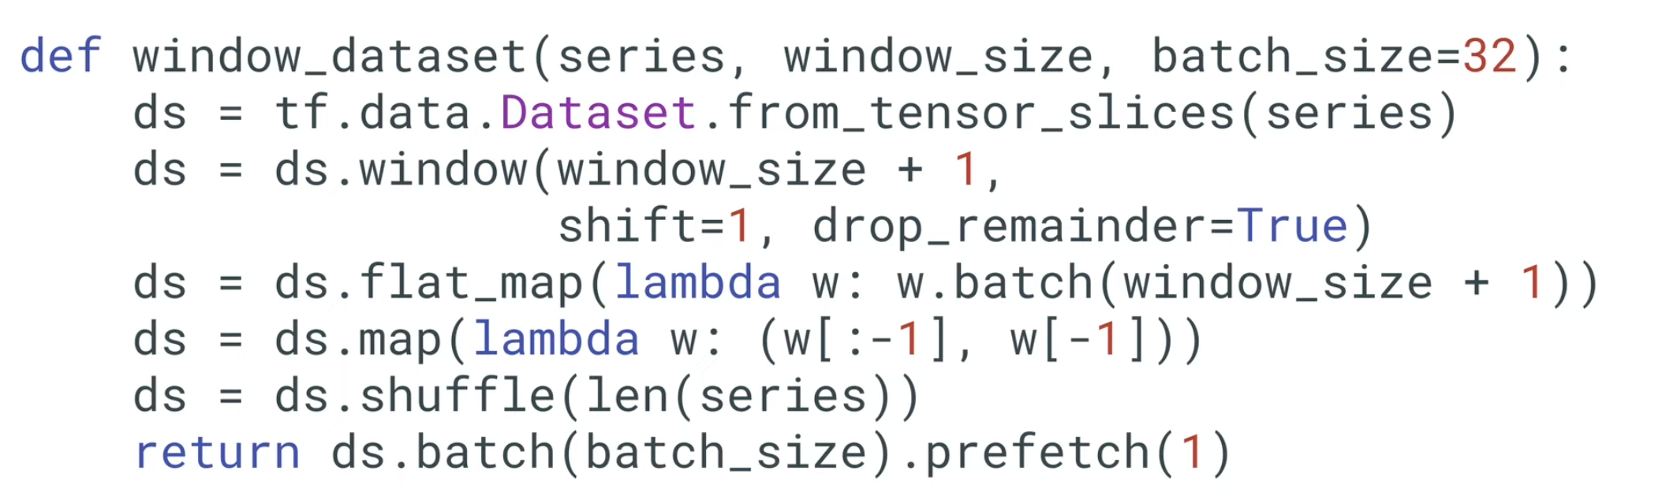
Time Windows

Slide 14
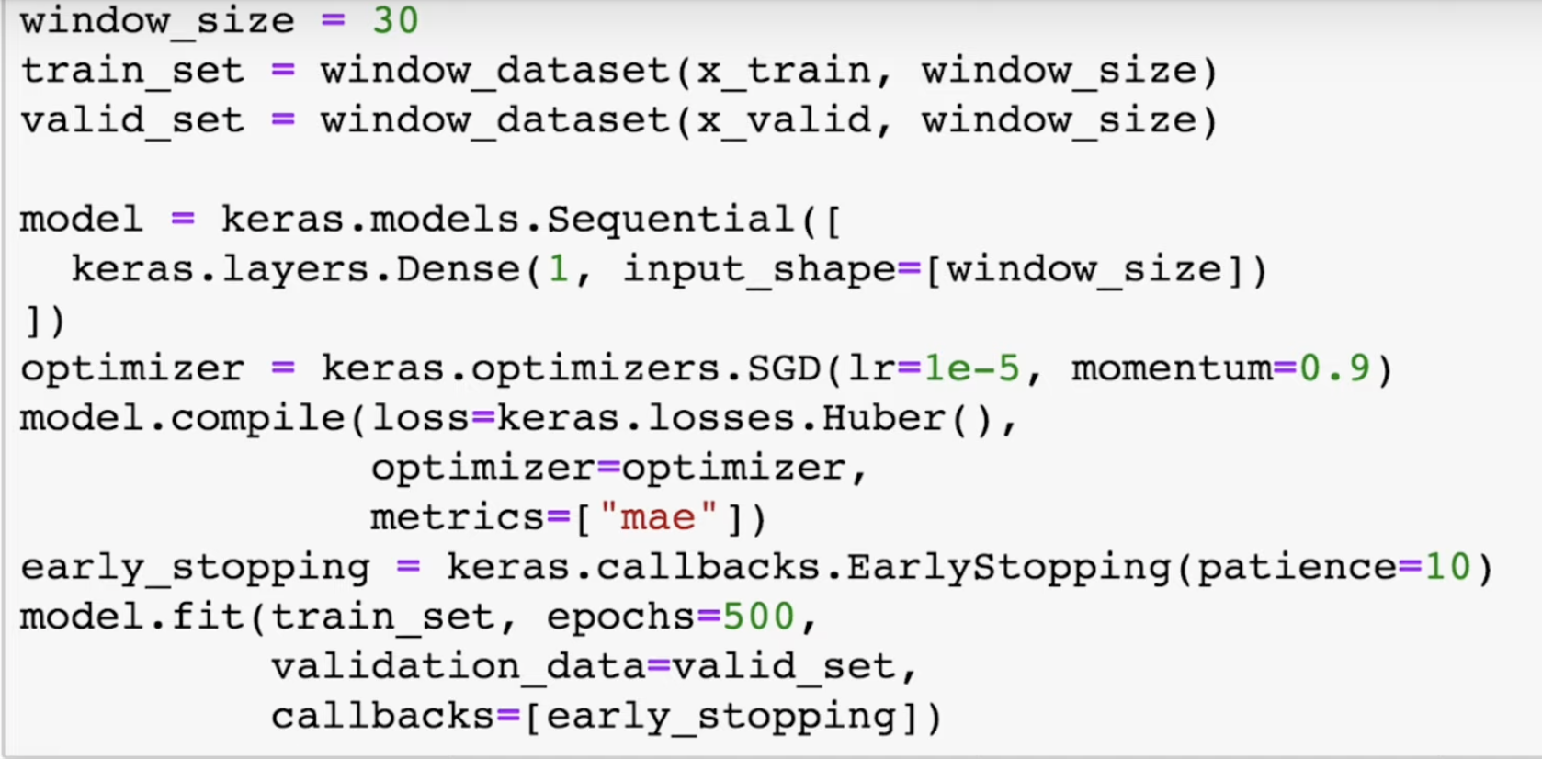
Forecasting with Machine Learning
EarlyStopping helps to overcome from overfitting

Slide 15
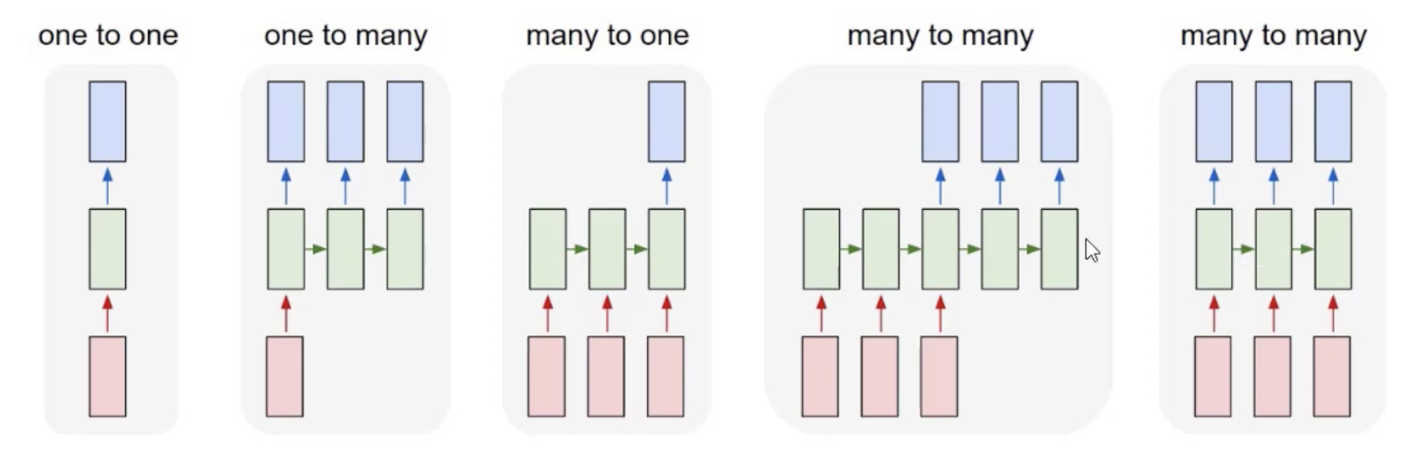

Image
Classification
Sentiment
Analysis: e.g multiple words in sentence gives sentiment and output is single
Language Translation
English to French
English to Spanish
English to Hindi
Synchronized many to many
Dog
Dog in field
Dog color is white

Slide 16
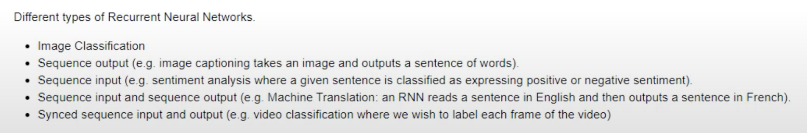

Slide 17
TimeSeries Approach
Naïve Forecasting: Tomorrow will be the same as today
Average Forecasting: Tomorrow will be close to the average of the values over the past few days e.g. (average of last 30 days).
Machine Learning
Dense layer model
RNN (Stateless)
RNN (Stateful)
LSTM
CNN

Slide 18
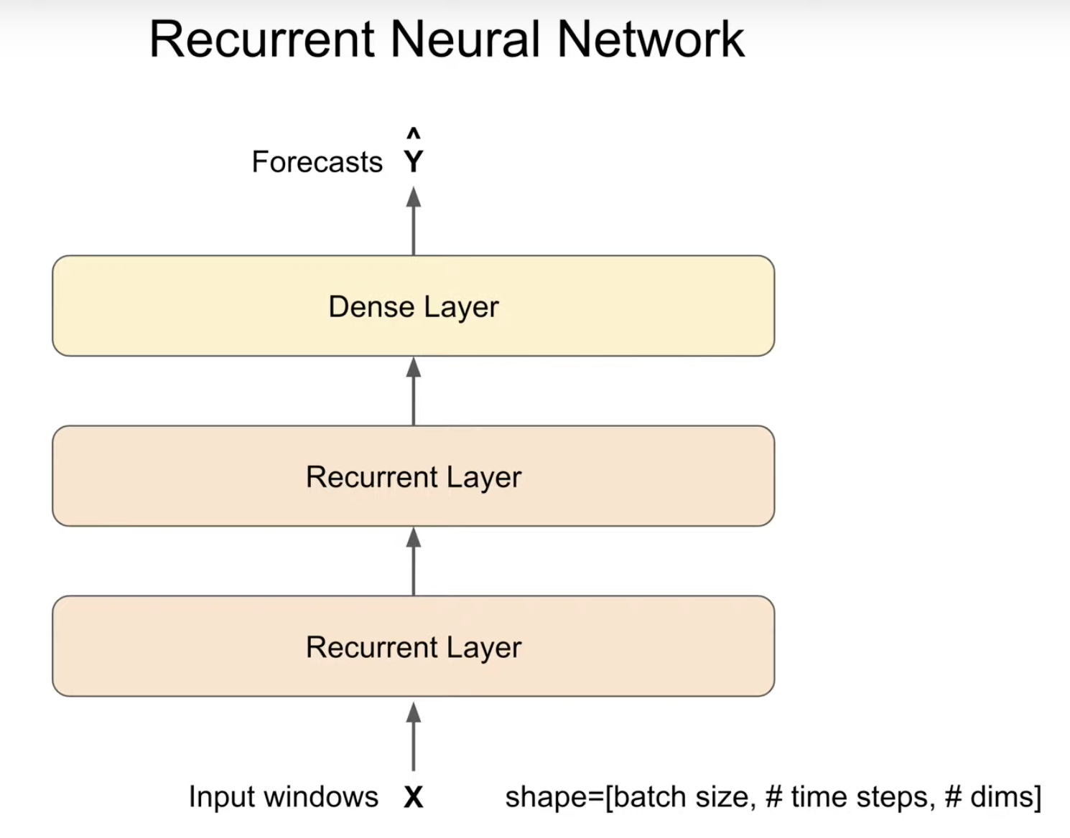
RNN – Recurrent Neural Network

Slide 19
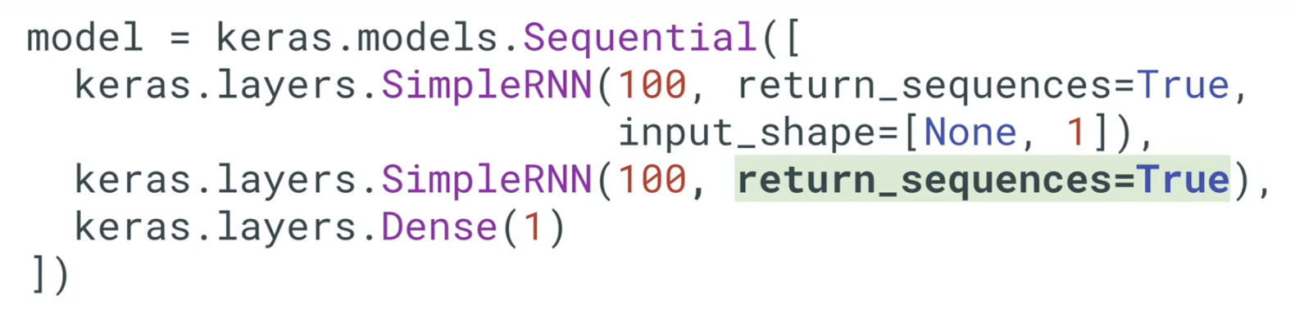
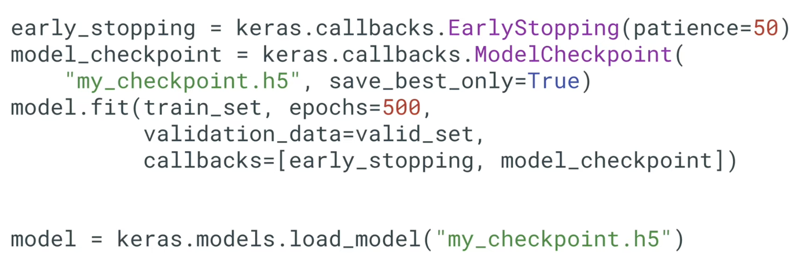
RNN
https://github.com/DineshChopra/AI-ML/blob/master/TensorFlow/TimeSeries6_RNN.ipynb

Slide 20
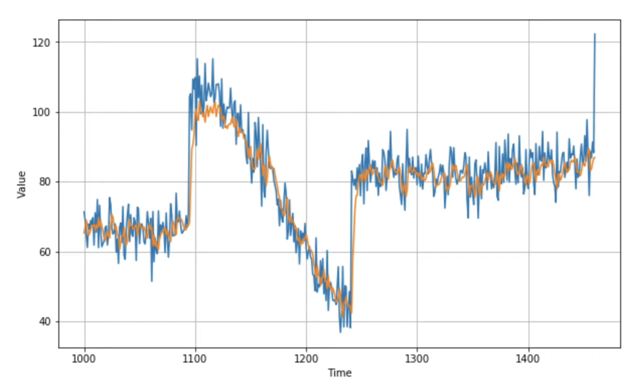
RNN Prediction
Error rate: 5.0

Slide 21
RNN
RNN is good
when we have a lot of training data for high-frequency,
When signal-to-noise ration is high

Slide 22
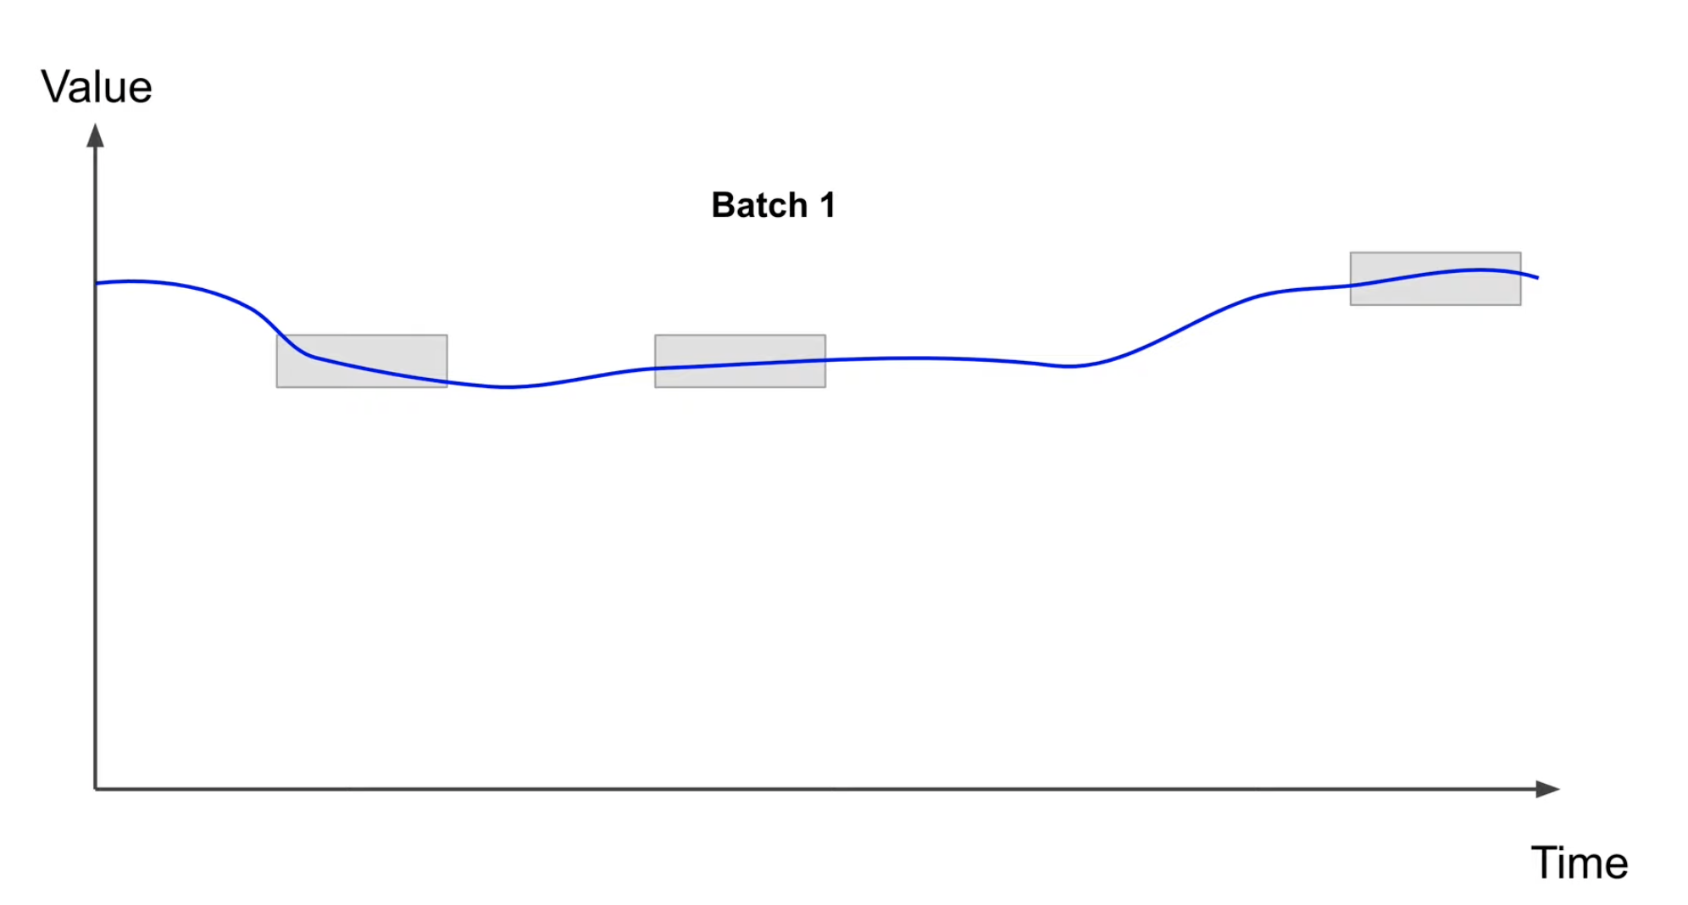
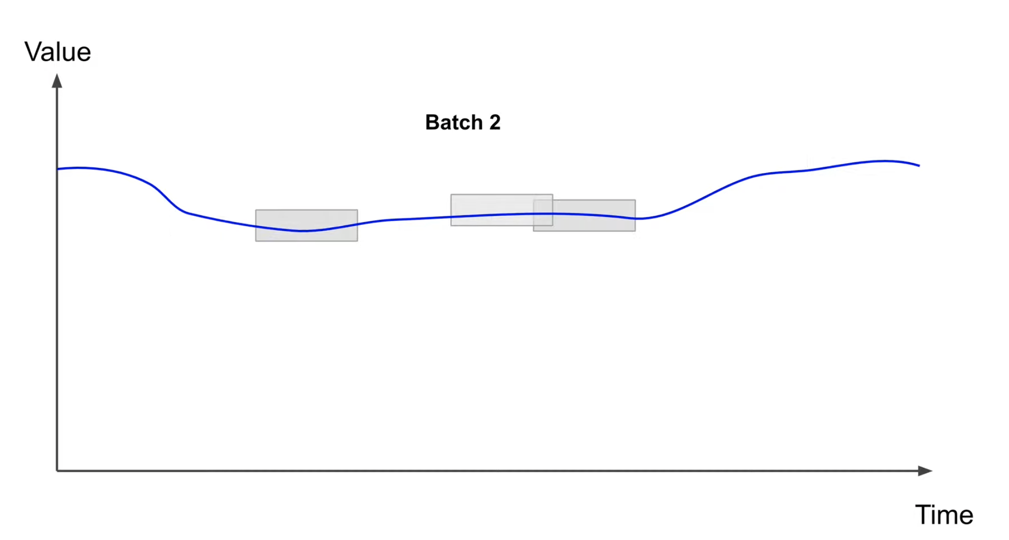
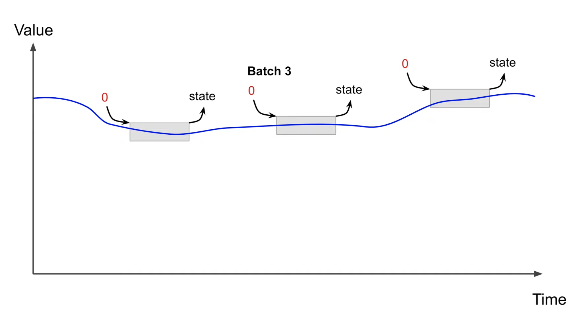
Stateless RNN
Use larger window At each batch it start from 0
Its nice and simple to use
They can not learn pattern longer than the length of window

Slide 23
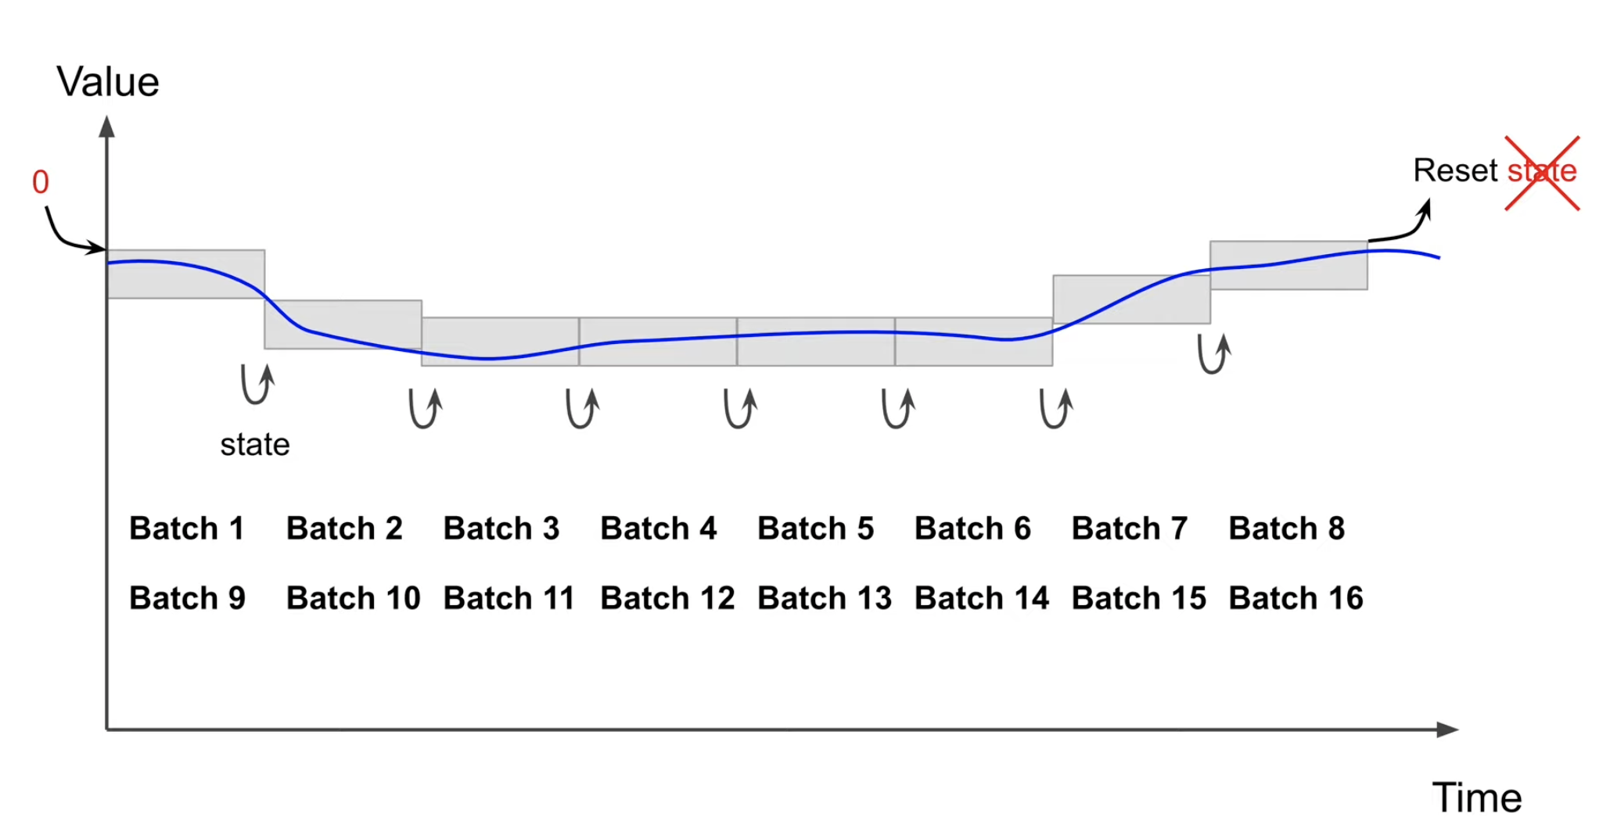
Statefull RNN
This is able to learn long term patterns
Downside is dataset is prepared very differently and easy to make mistakes
Training will be slow
Statefull RNN are much less used than a stateless RNN

Slide 24
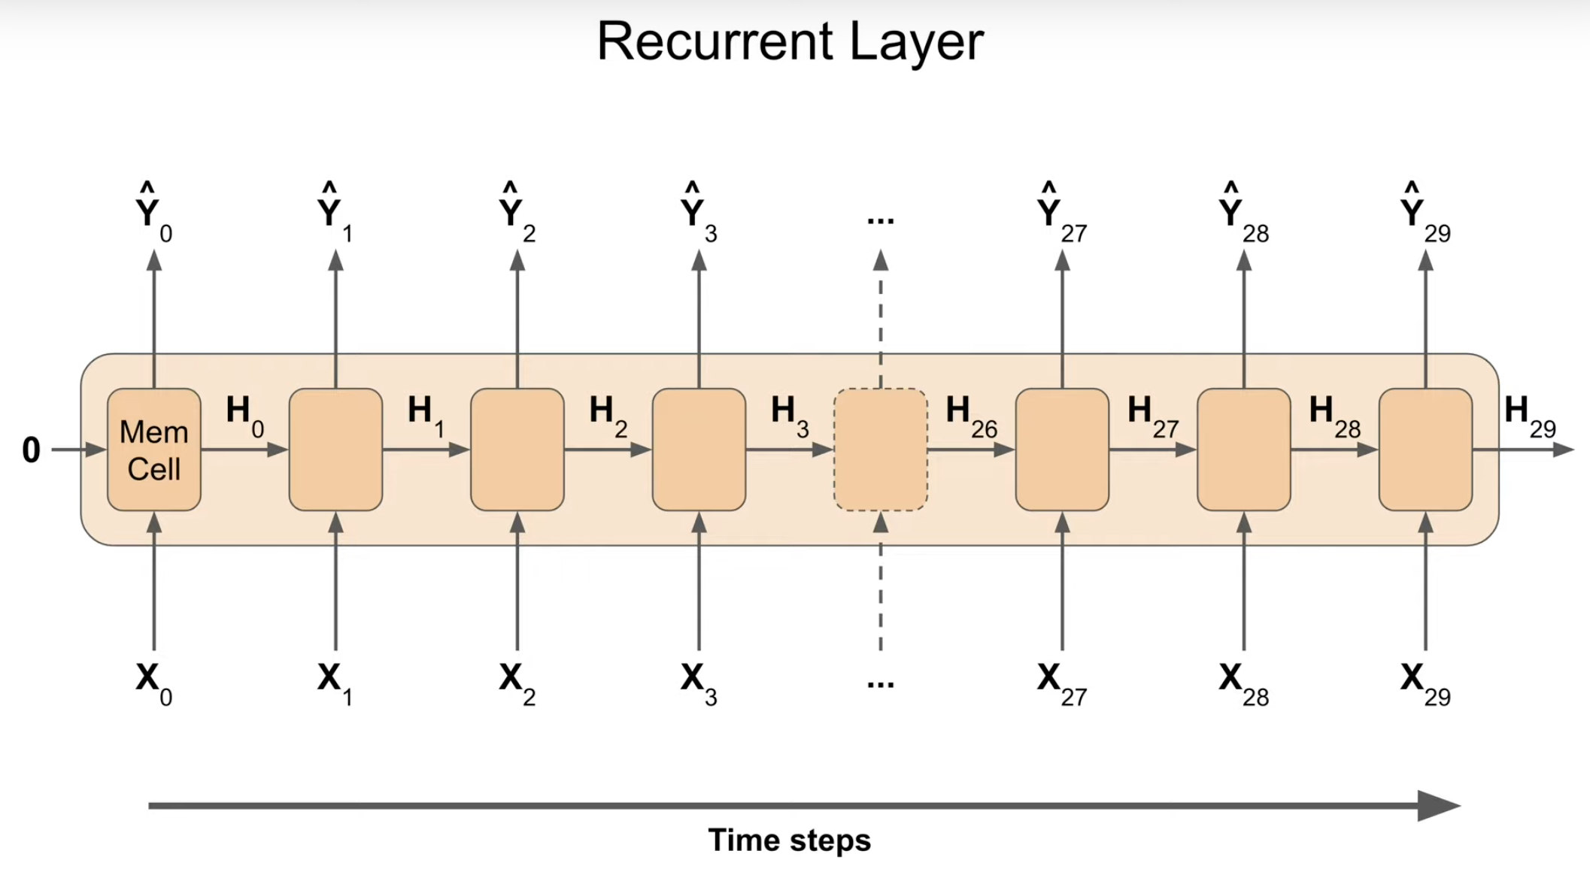
RNN – Recurrent Neural Network (State Full)

Slide 25
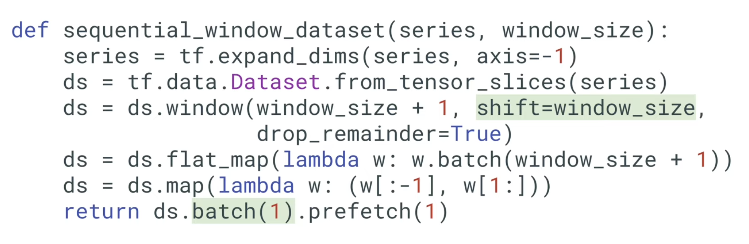
Statefull RNN – Prepare dataset
Shift = window_size, each window will immediately follow the previous window
No need to shuffle, they need to be consecutive
Batch contains a single window

Slide 26
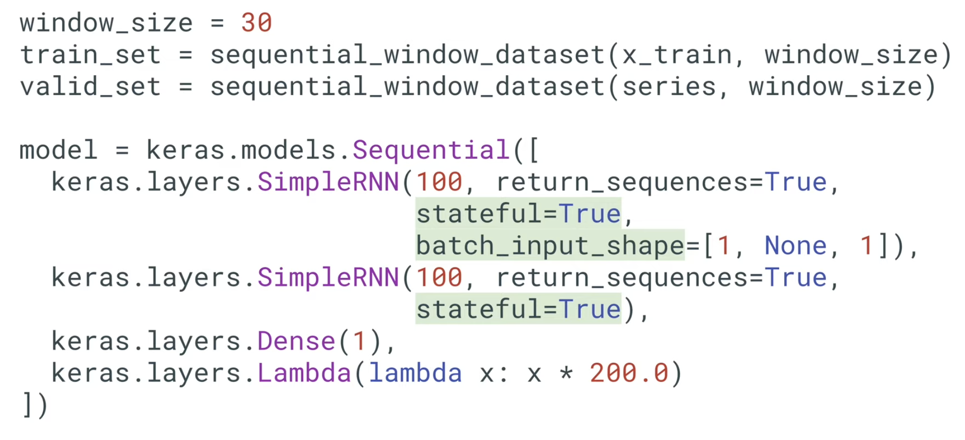
Stateful RNN

Slide 27
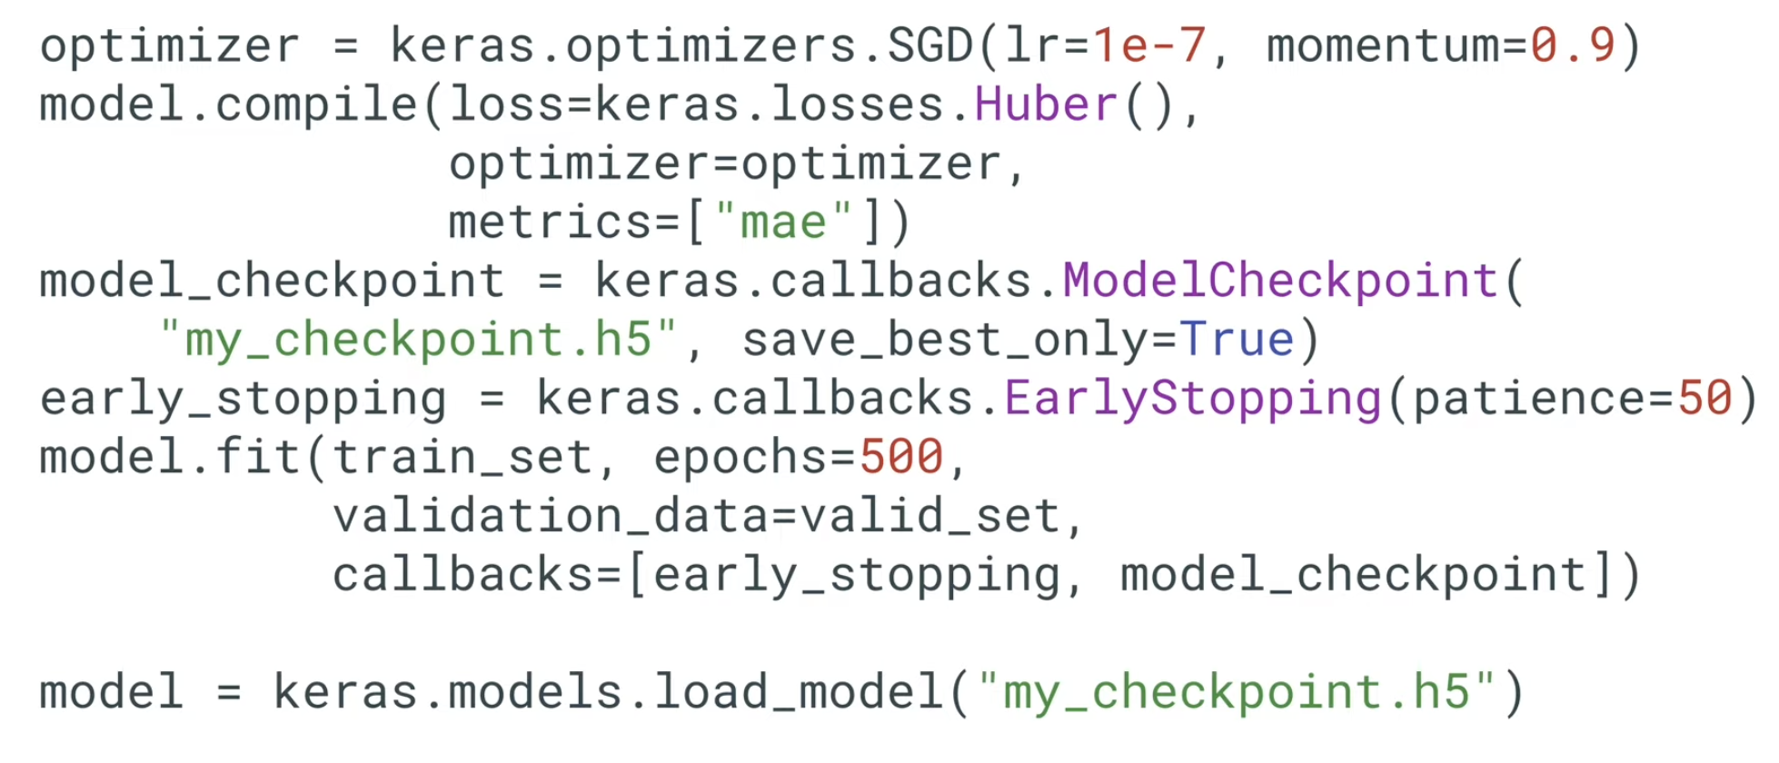
Stateful RNN

Slide 28
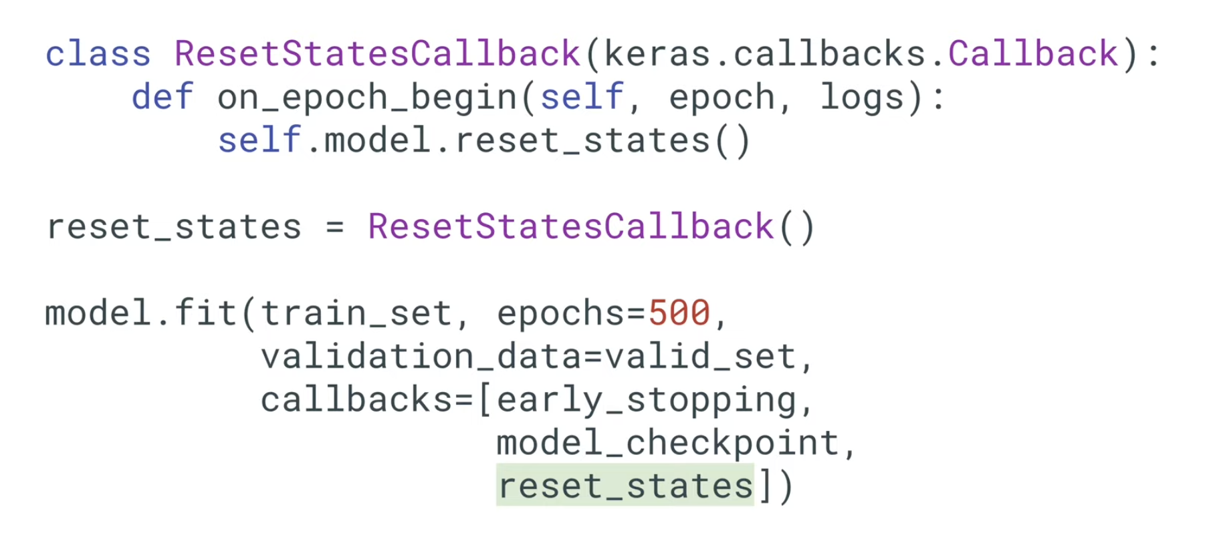
Stateful RNN

Slide 29
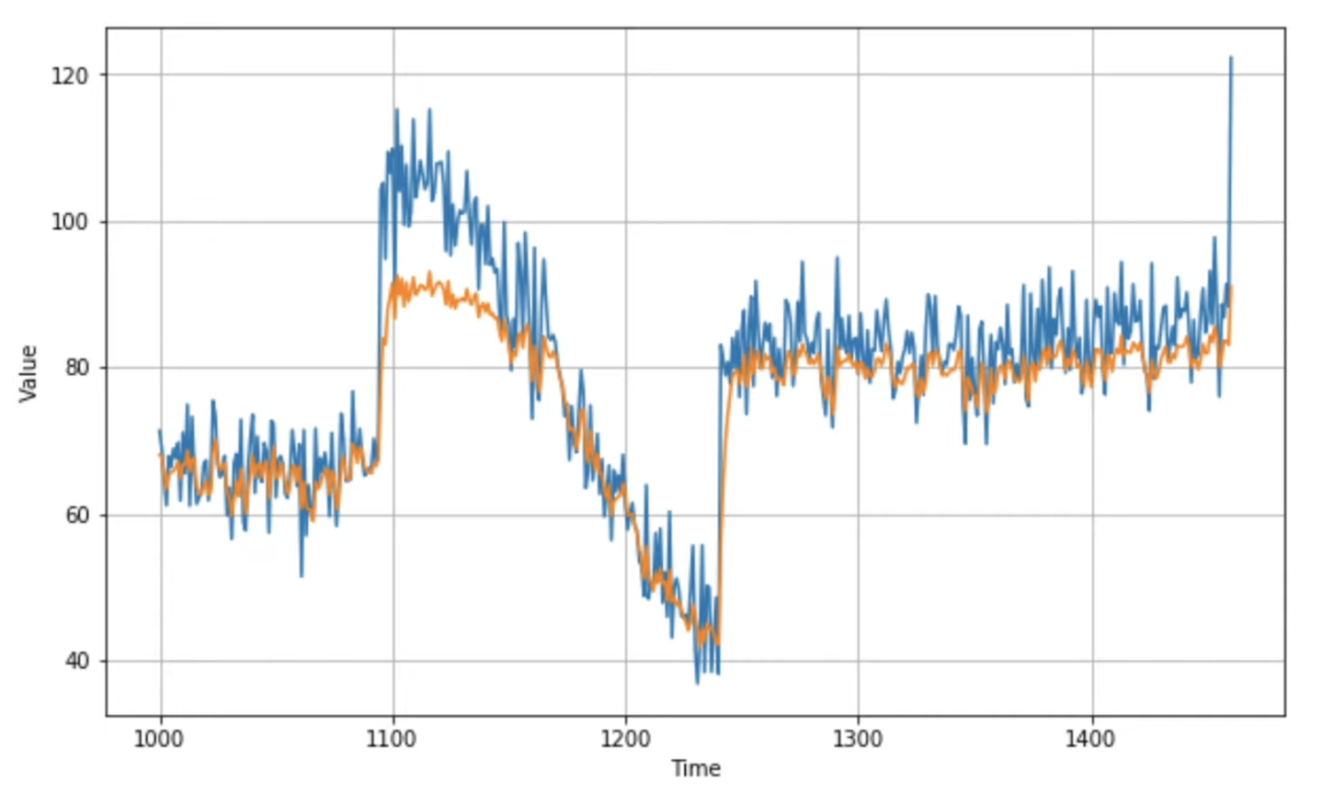
Stateful RNN

Slide 30
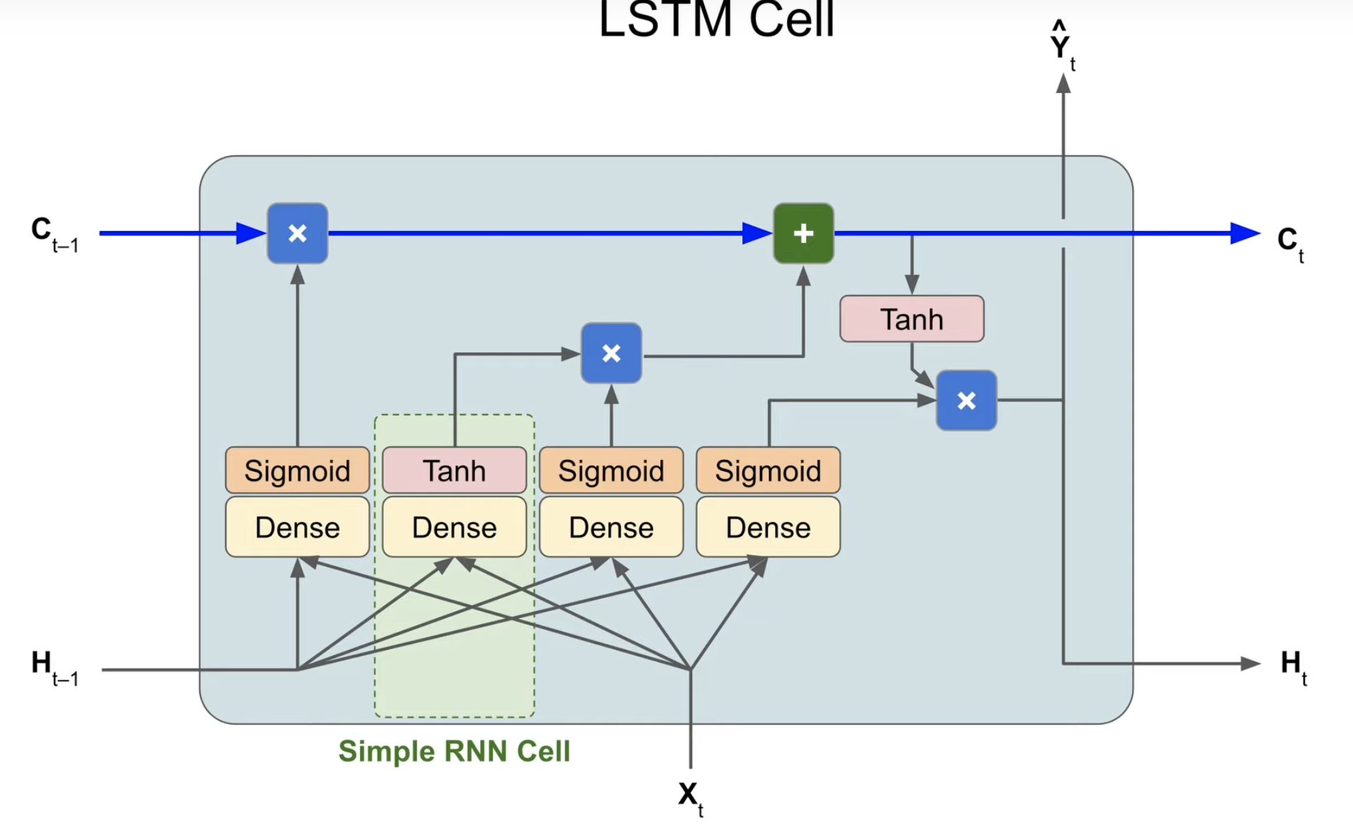
LSTM – Long Short Term Memory

Slide 31
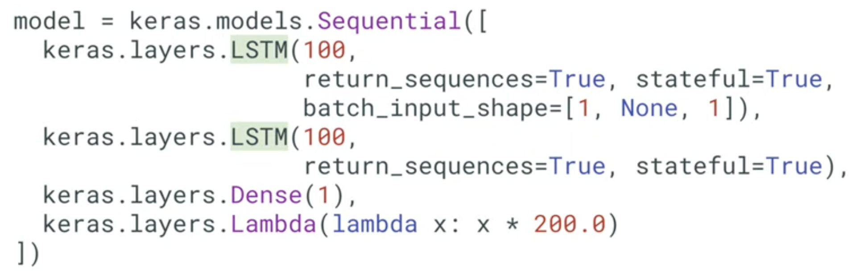
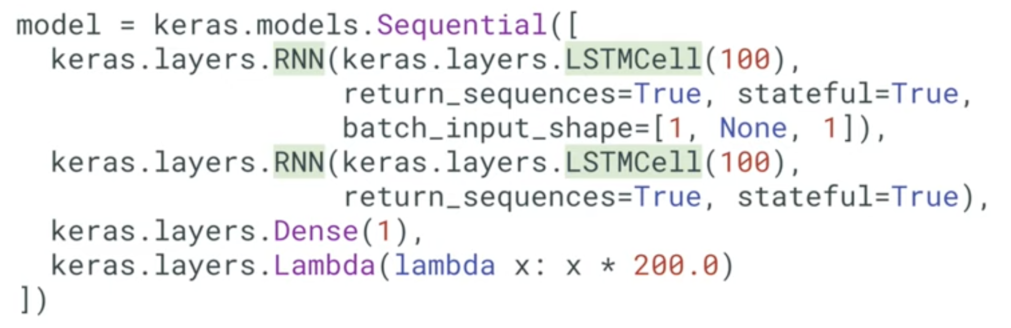
LSTM – Long Short Term Memory
https://github.com/DineshChopra/AI-ML/blob/master/TensorFlow/TimeSeries8_LSTM.ipynb

Slide 32
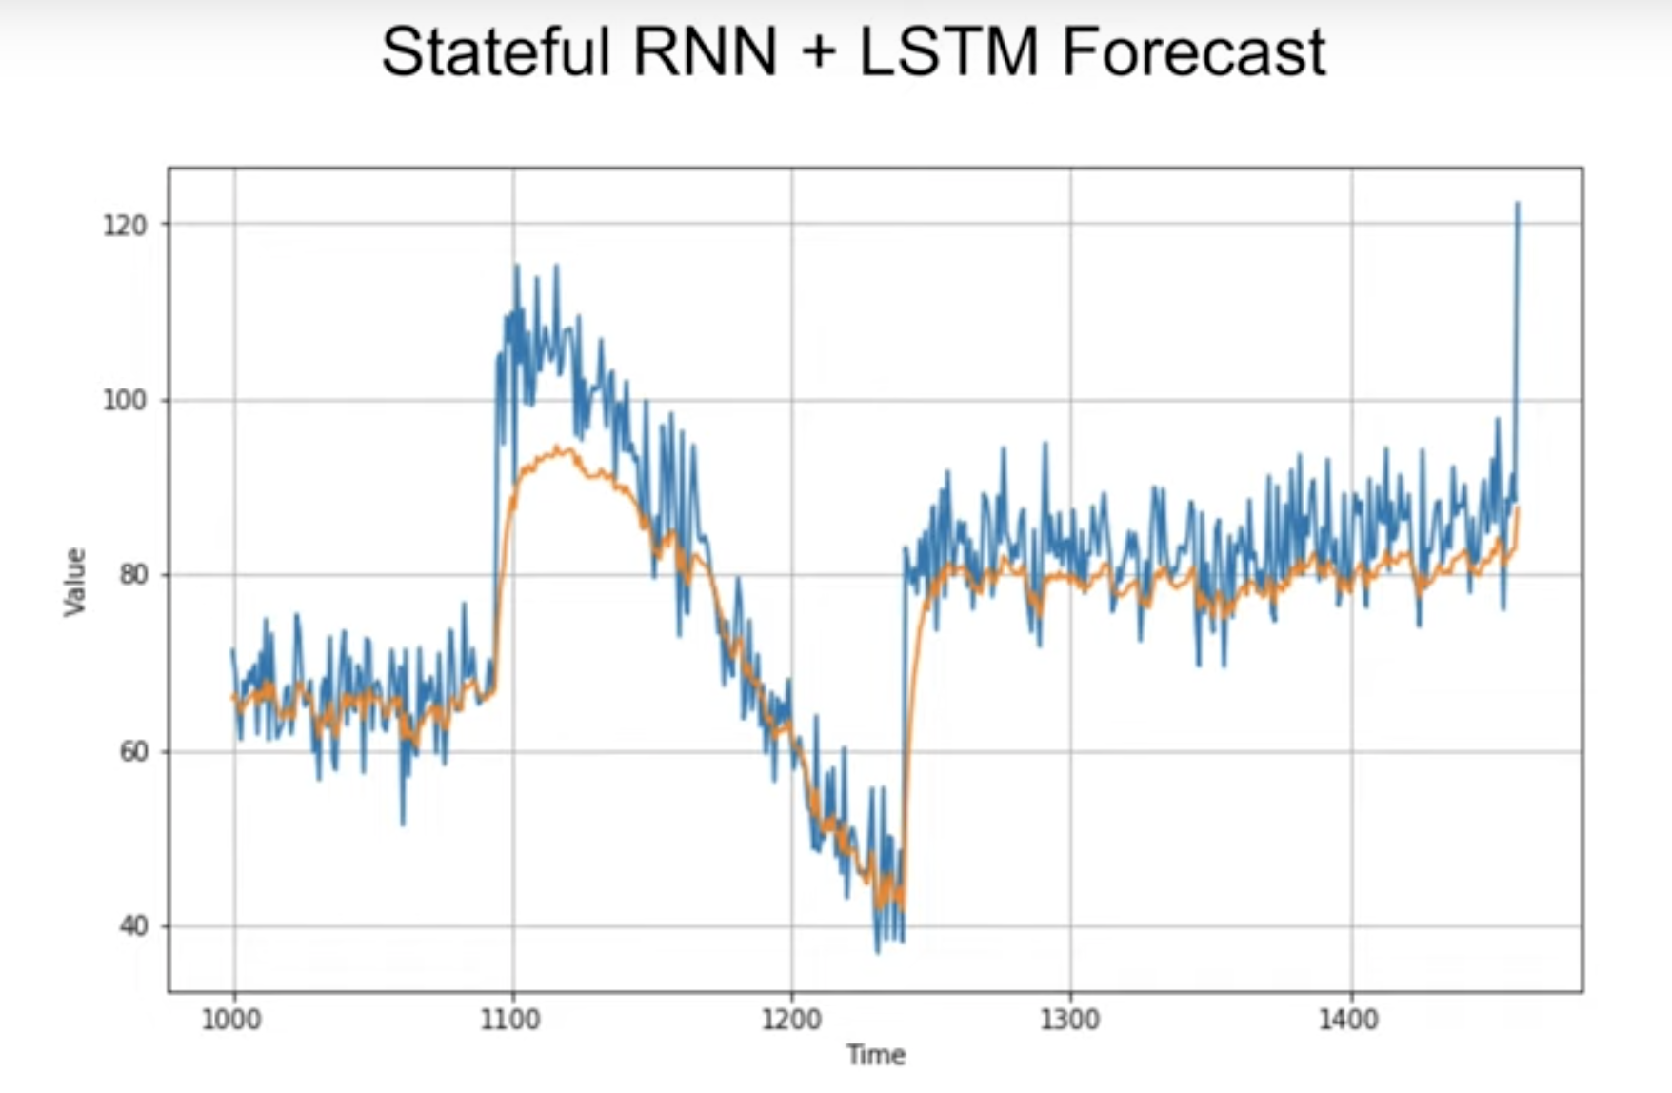
LSTM – Long Short Term Memory Prediction
Mean absolute error = 5.1

